Slide 1
Learning to read: supporting your child at home
Learning to read is one of the most important skills that your child will develop over the next few years. The more support and encouragement that you can offer your child, the more likely it is that he or she will make good progress.
At school we are using the Oxford Reading Tree series to take your child through the early stages of learning to read. To reinforce the teaching in school, your child may bring home some books to share with you.
These may be:
● Floppy’s Phonics Decoding Practice books, to practise each set of new sounds and letters taught at school and consolidate learning.
● Floppy’s Phonics decodable readers to practise reading stories and different text types.
All the books have notes on the inside cover to guide you on how to share them with your child. We may also send home Grapheme and Picture Tiles, Activity Sheets, Cumulative Texts, Activity Books and Say the Sounds Posters for your child to practise phonics at home. You may like to visit www.oxfordowl.co.uk for further information about phonics, helping your child to read and for free resources and eBooks.

Slide 2
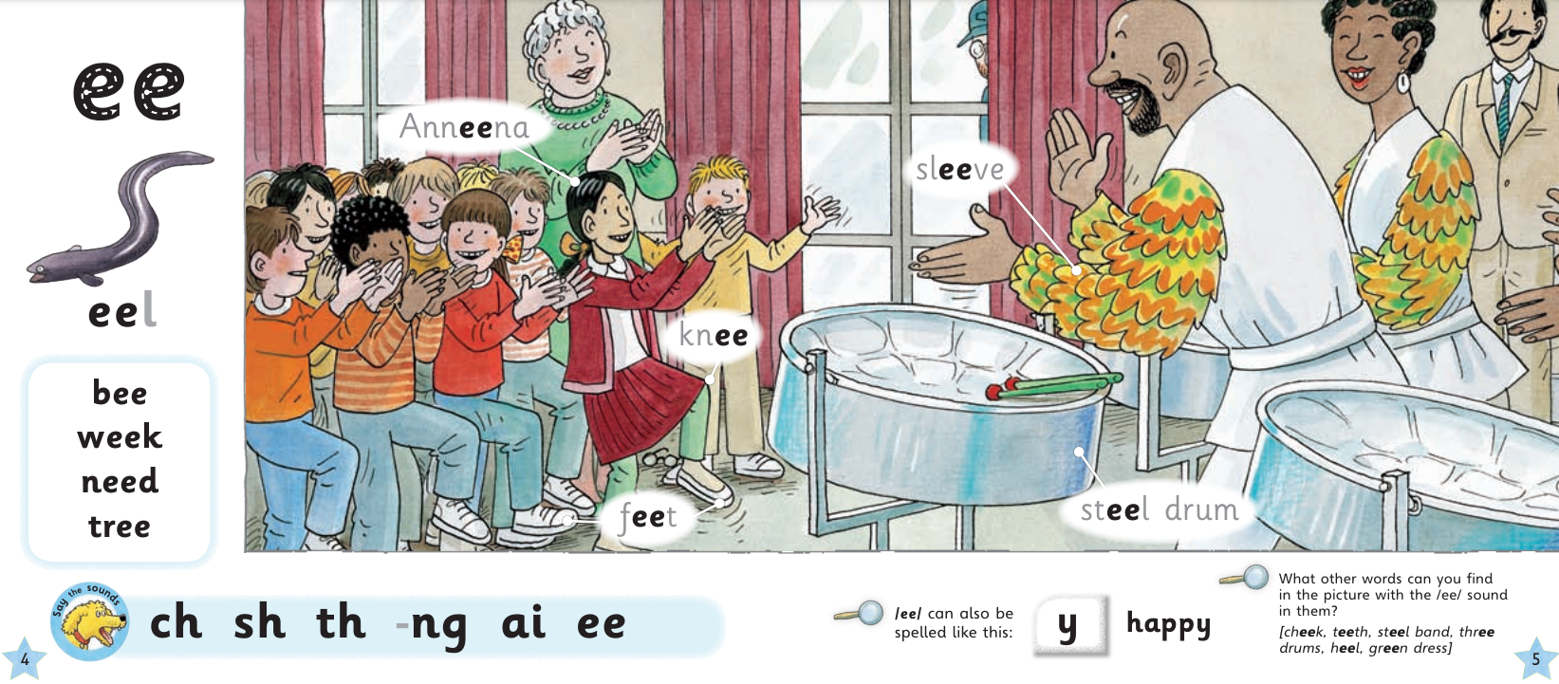
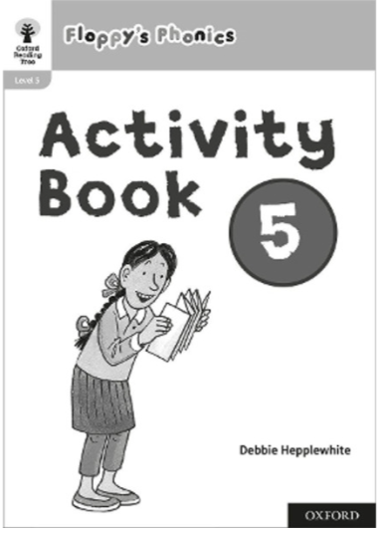
Floppy’s Phonics Scheme
Alongside the reading books, we are using the Floppy’s Phonics teaching programme, which is a step-by-step phonics reading scheme. It introduces the children to the letters and sounds (the alphabetic code) that are at the foundation of all reading and writing.
We use online interactive pages alongside activity booklets.

Slide 3
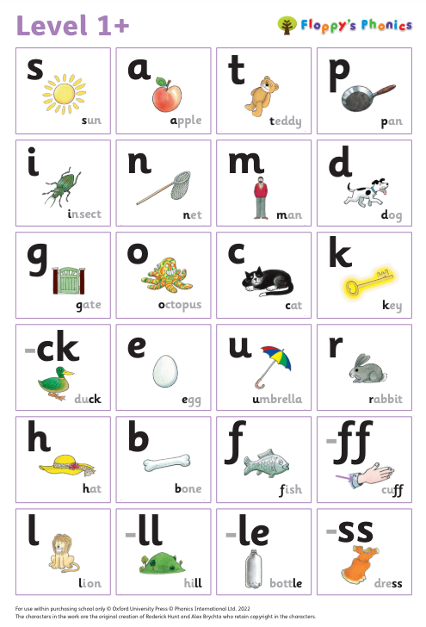
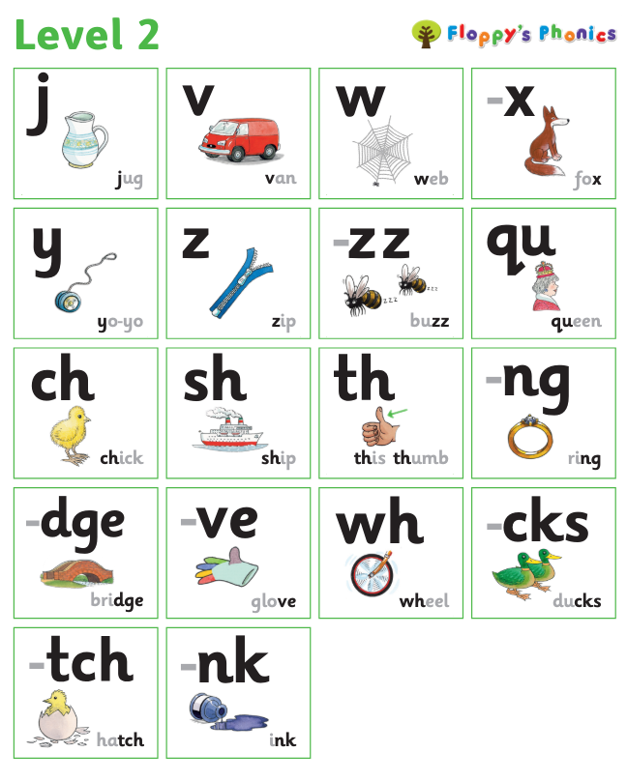
Useful Sound Mats – Levels 1 and 2

Slide 4
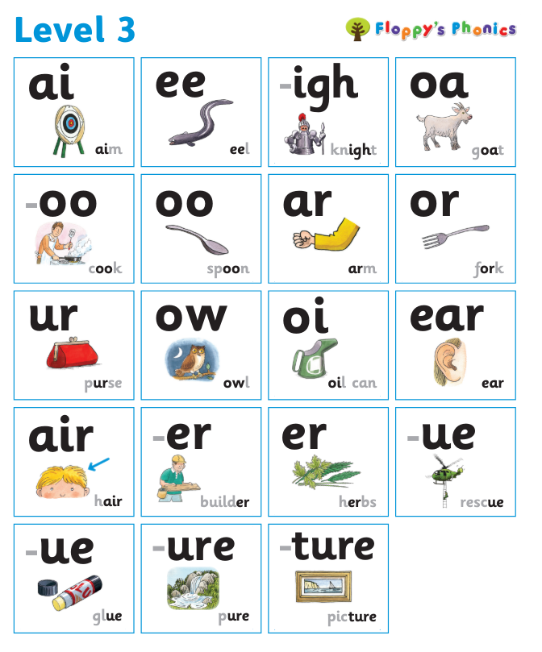
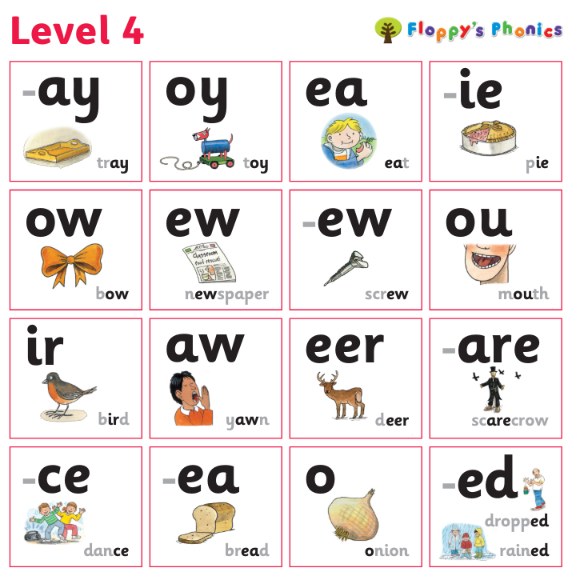
Useful Sound Mats – Levels 3 and 4

Slide 5
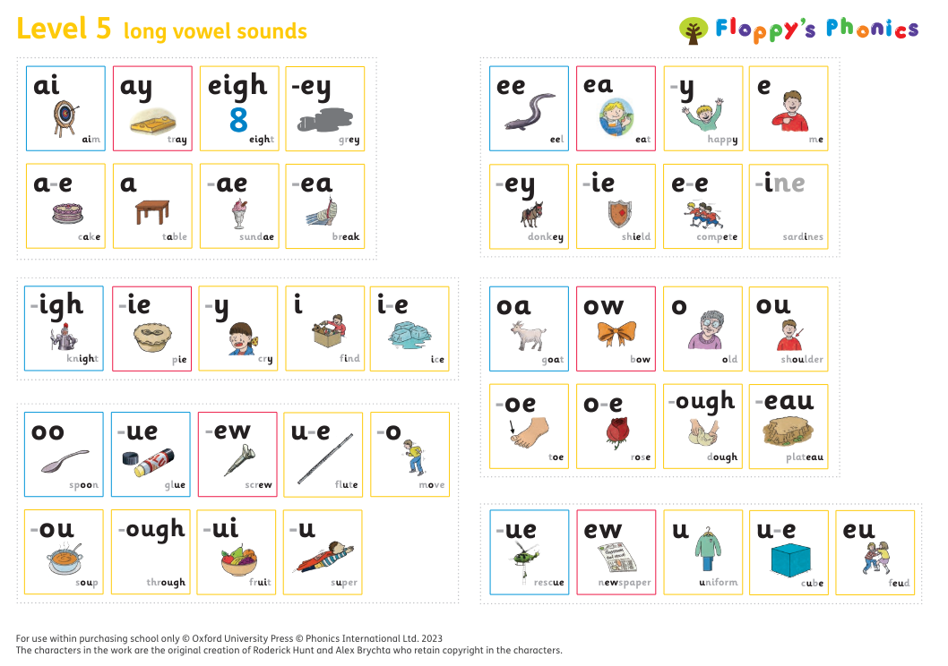
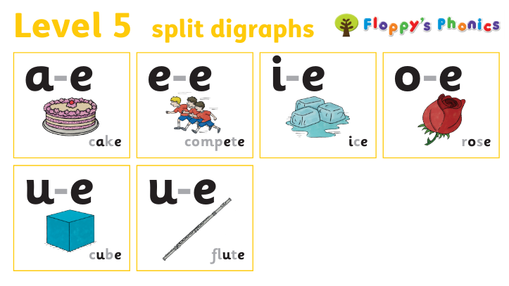
Useful Sound Mats – Level 5

