Slide 1

Curriculum and assessment parental Information Evening

Slide 2
Agenda
Outline the rationale behind the curriculum at St Mary’s.
Provide an overview about how learning is embedded through the curriculum.
Discuss how our curriculum is planned and organised.
Highlight where information can be found on our school’s website.
Provide information about the different assessment procedures at St Mary’s

Slide 3
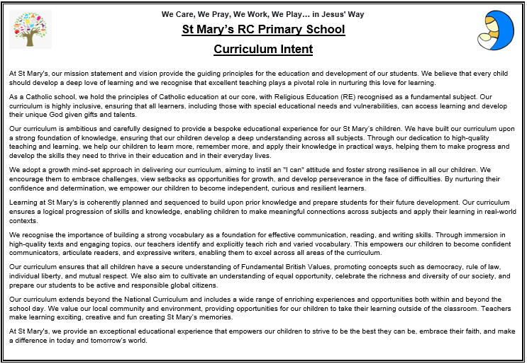
Curriculum Intent

Slide 4
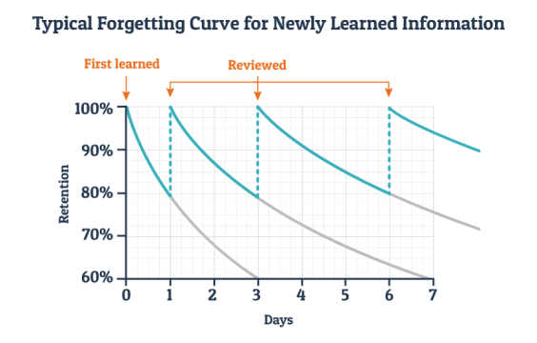
Retrieval – Building a deep understanding
Retrieval is when children are given the opportunity to find knowledge or practise skills after they have learned it.
Each time they retrieve information, it increases their ability to keep the information and learn it.
Our curriculum is built to help with this retrieval.

Slide 5
Mental models
Experience
Apply
Mental Model
Experience
Problem Solving
Experience
Apply
Retrieval

Slide 6

Let’s Remember More
Last lesson | Last week What are the four compass directions?
Last term | Last year groups What is the capital of England?

Slide 7
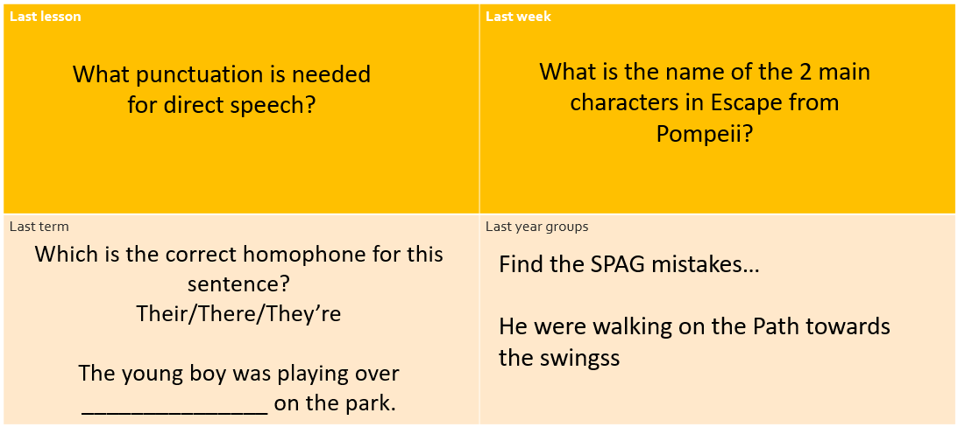
Let’s Remember More

Slide 8
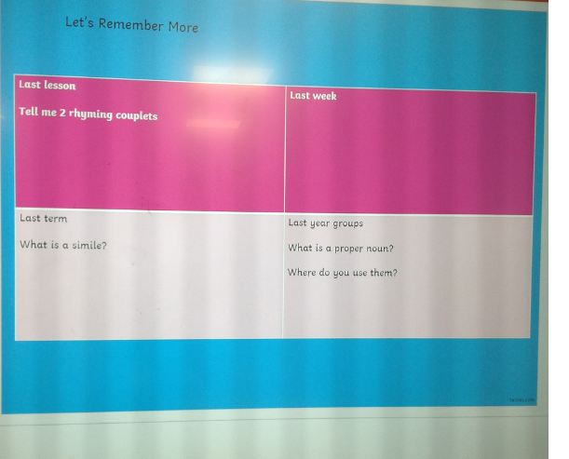
Let’s Remember More

Slide 9
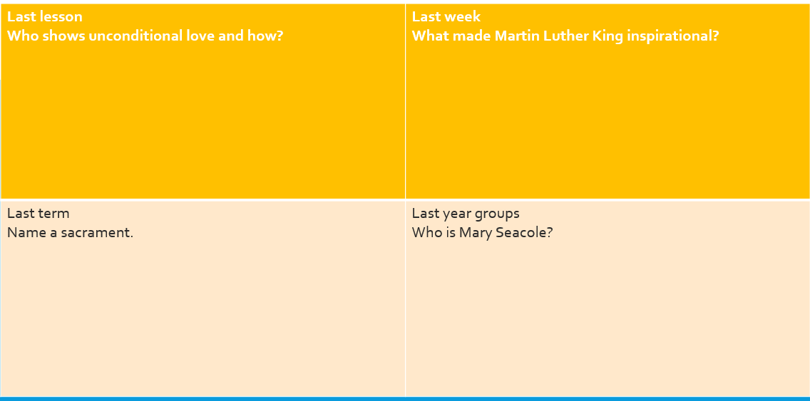
Let’s Remember More

Slide 10
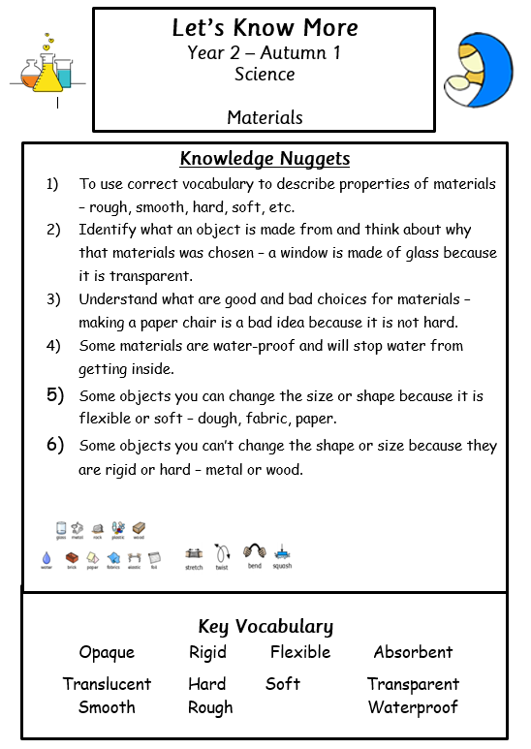
Let’s Know more
Children will stick these in when they start a new topic – they
will tick if they think they know – dot if they don’t know.
Children can use these to understand what learning they have
done and what learning will come next.
Vocabulary – children can revisit these words within lessons.
School website for parents to use and support at home.

Slide 11
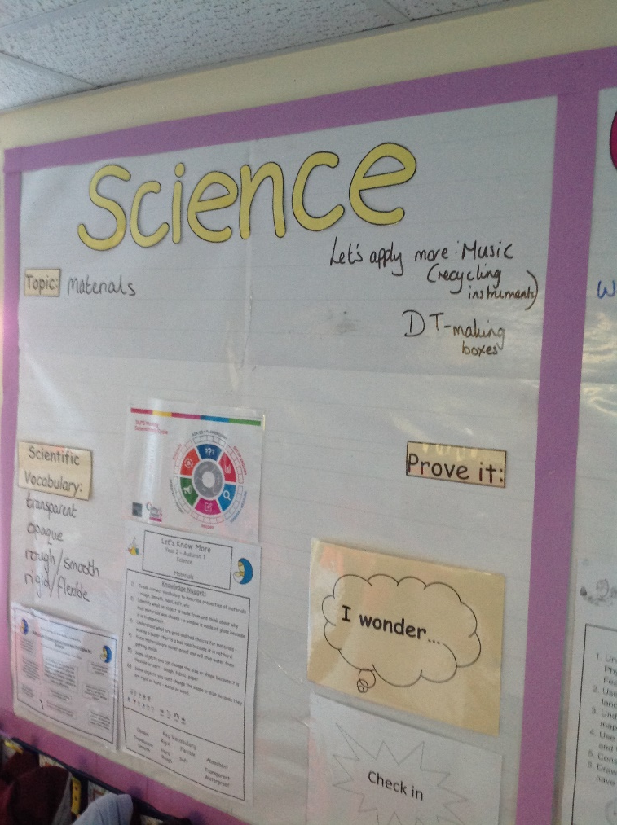
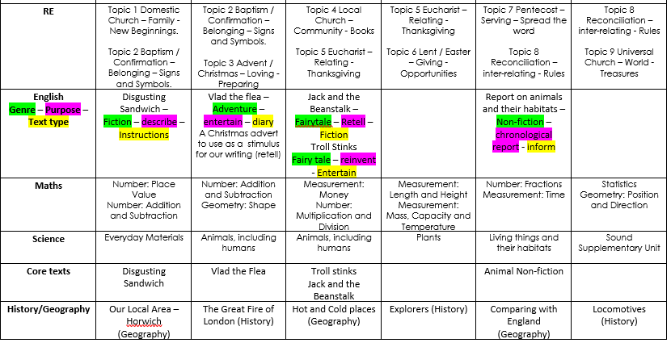
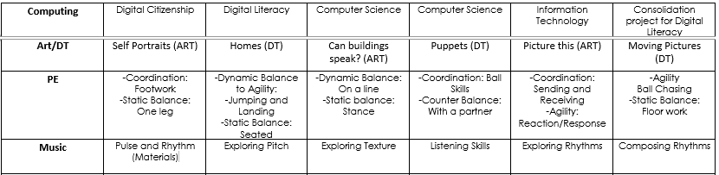
Let’s Apply more
Opportunity to use learning from
one subject in another.
Allows children to retrieve information
within a different context.

Slide 12
Curriculum Sequencing
Our curriculum
At St Mary’s is designed
so that learning builds
on between subjects
and years groups to
support children being
able to retrieve previous
knowledge learnt.
Subjects are also linked
together to create stronger
connections in their learning.

Slide 13
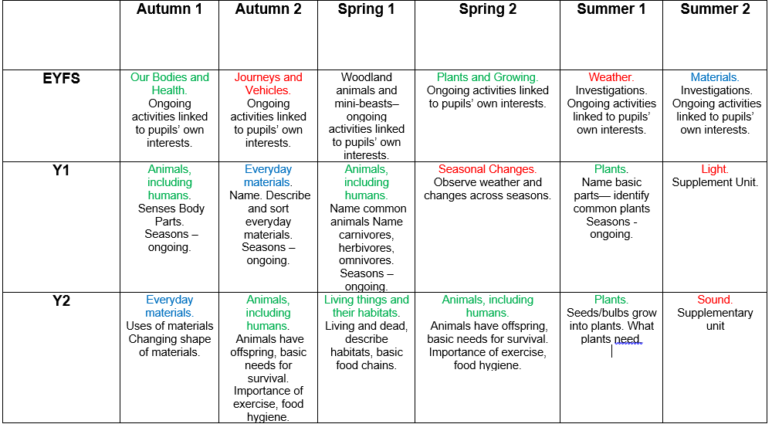
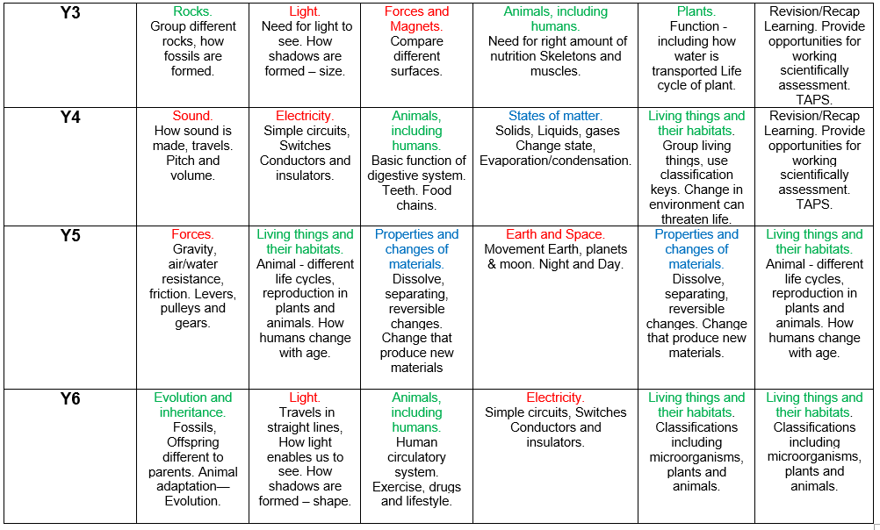
Curriculum Sequencing

Slide 14
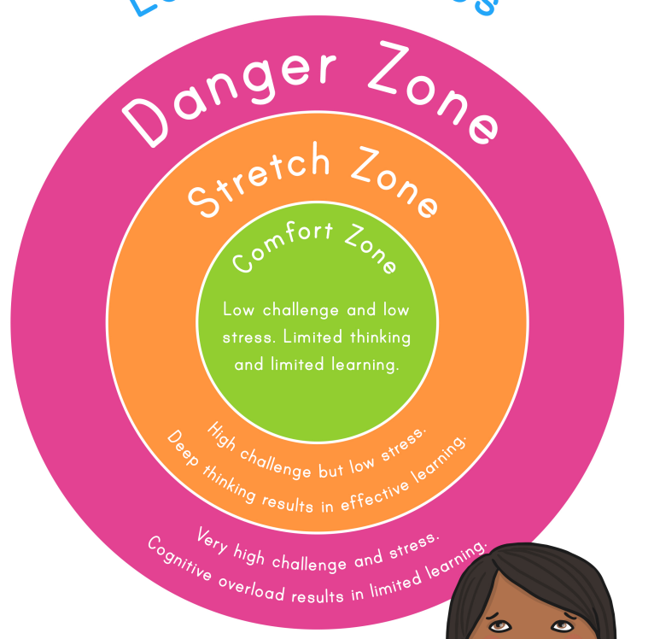
Growth Mindset
Growth mindset is all about creating resilience.
Providing the children with the knowledge and skills to stretch themselves.
When children are stretched, this is when they learn the most.
Growth mindset is not about making things
difficult.

Slide 15
Stretching pupils
Stretching your pupils is not about creating something that is difficult.
Stretching is about allowing the children to retrieve knowledge, and apply this knowledge in lots of different ways.

Slide 16
How do we stretch our children?
Questioning!
How you use questioning is the easiest way to stretch your children.
Explanation – true/false, correction, method, choice of material
To give feedback
Applying in a different way
Improving

Slide 17
When within a lesson
We want to avoid children associating challenge to the end of the lessons – questioning should be used throughout the lesson.
Input is a brilliant time to use questioning.
Live marking within lessons.
Reasoning within their task.
‘Think about it’ as an extra task for those that have achieved that lesson.

Slide 18
Great question starters
Can you explain?
What’s your opinion on?
Are you sure?
What do you notice?
Always, sometimes, never.
True or false?
How do you know?
Can you prove it?
Similar? Different?
Can you explain?

Slide 19
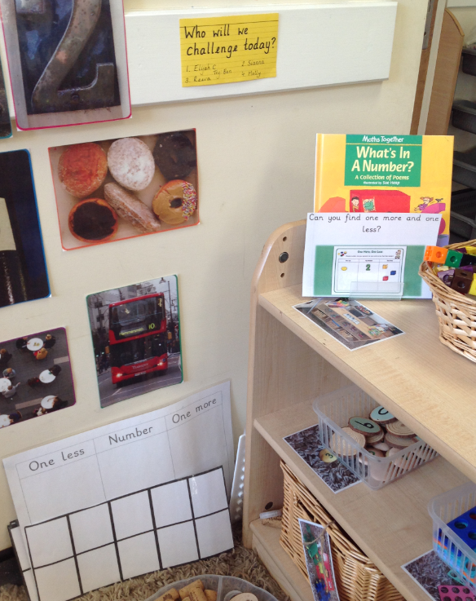
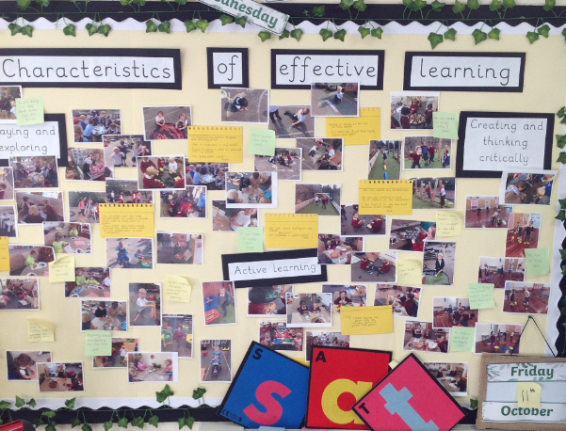
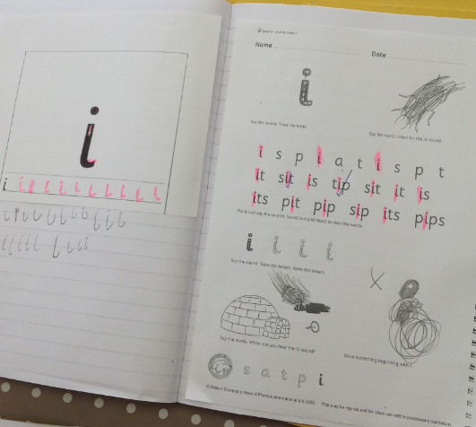
Think about it

Slide 20
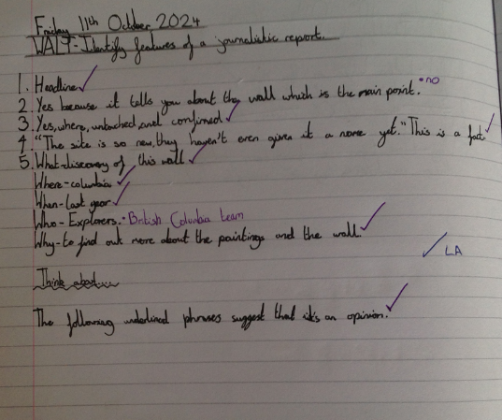
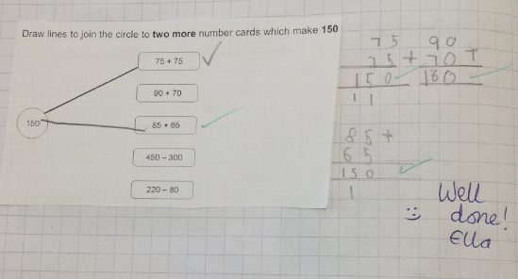
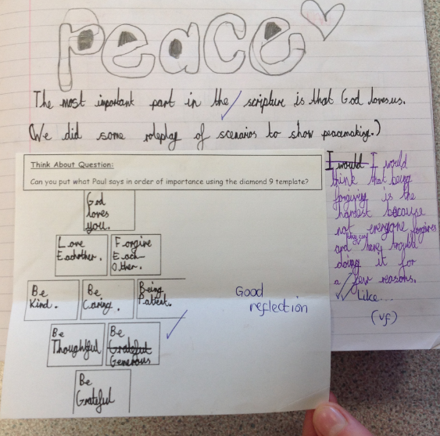
Think about it

Slide 21
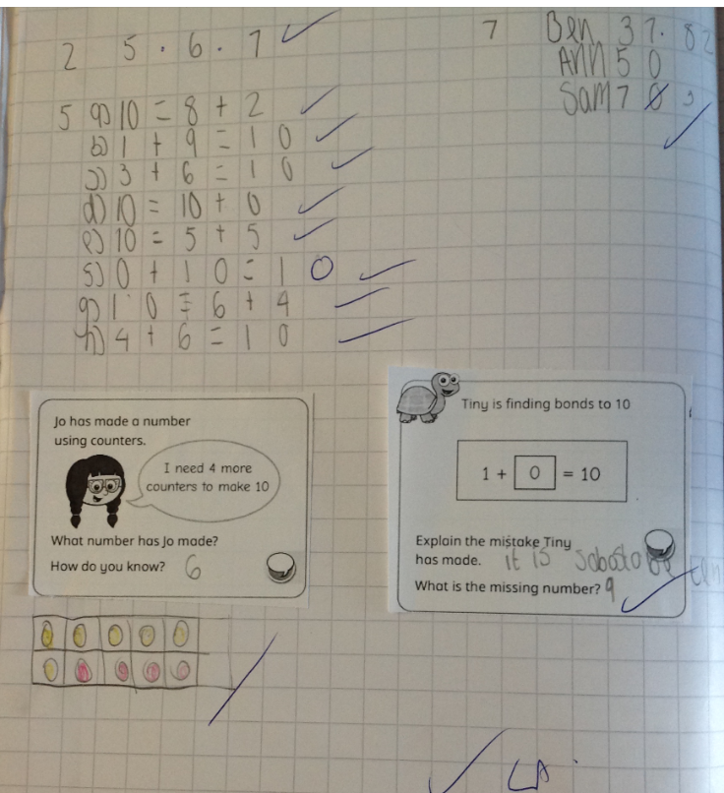
Think about it
Think about it - are questions presented to allow children to think more openly about their learning and as an opportunity to explain themselves.

Slide 22
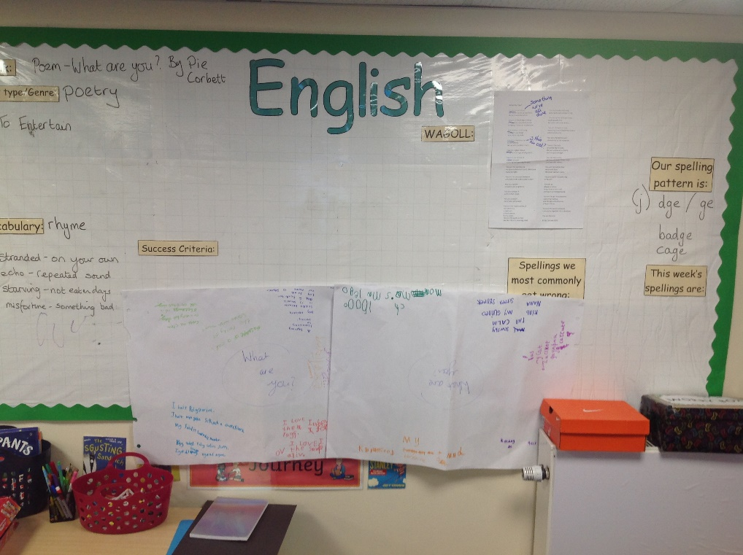
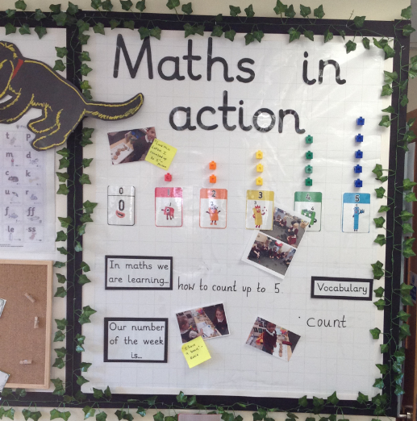
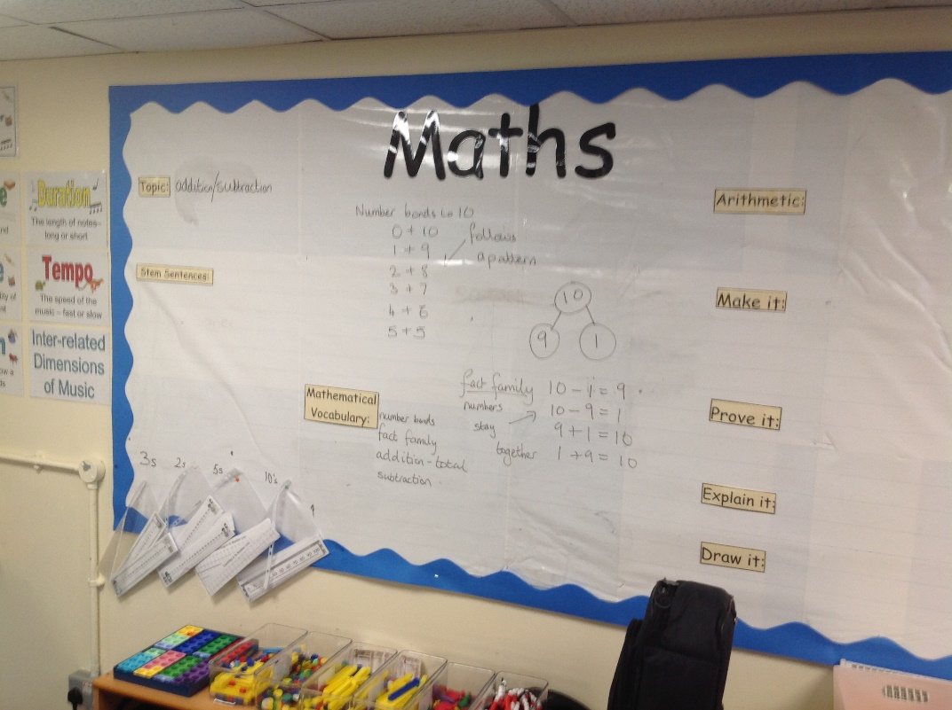
Working Walls

Slide 23
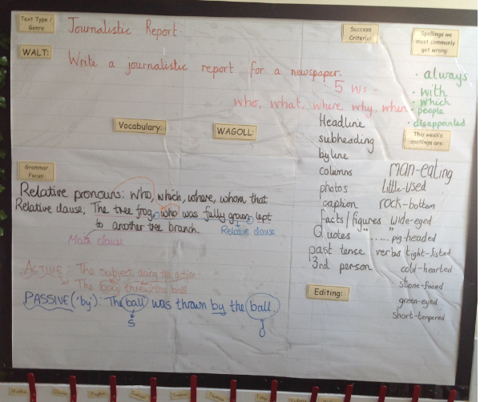
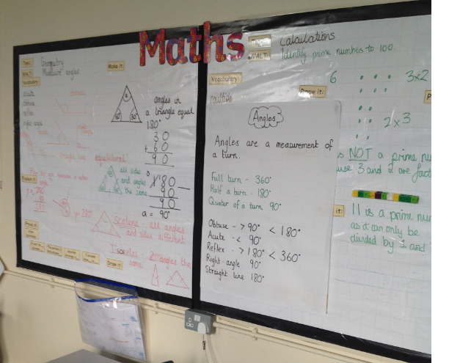
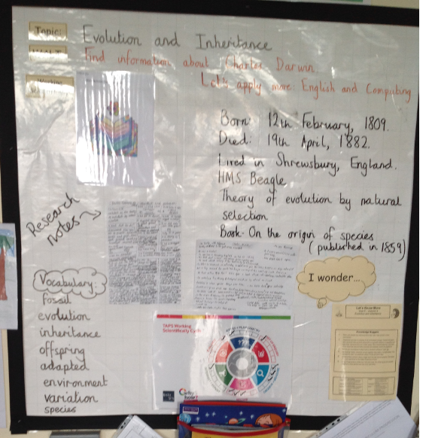
Working Walls

Slide 24
School Website
The school website is updated each half term with the relevant information.
If you want to see daily life within the school – follow our school’s Facebook.

Slide 25

What is Assessment?
Many people assume that ‘assessment’ means taking a test, but assessment is much more than that.
It is fundamental in extending and challenging children’s learning so that they can reach their true potential.
At St Mary’s we use 2 types of assessment – Formative and Summative. These are sometimes referred to as assessment of learning and assessment for learning, respectively. Both happen in the classroom.
Assessment is only affective if there is regular review and it is acted upon at all levels. Research has shown that children’s involvement in their own assessment empowers them to take action towards improving their performance

Slide 26
Formative Assessment - ONGOING
This is Ongoing Assessment for learning. It involves the use of assessment in the classroom to raise pupil achievement. It is based on the idea that pupils improve most if they understand the aim of their learning, where they are in relation to this aim and how they can achieve it.
Formative assessment takes place on a day-to-day basis during teaching and learning, ever lesson begins with a WALT which allows children to know from the onset the purpose and the learning of that lesson. If a teacher and pupil understand what has been achieved to date, it is easier to plan the next steps. As the learning continues, further formative assessments indicate whether teaching plans need to be amended to reinforce or extend learning.
Formative assessments may be questions, tasks, quizzes. Often formative assessments may not be recorded at all, except perhaps in the lesson plans drawn up to address the next steps indicated.
Children’s work is marked by the teachers using a clear code that the children understand – you will see this when you come into school to look at your child’s books every term

Slide 27
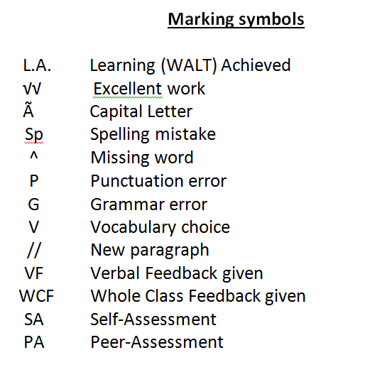

Formative Assessment - ONGOING
CHECK
and
NEXT STEPS

Slide 28
Summative Assessment - SNAPSHOT
This is Assessment of the learning. It involves comparing pupil’s performance against age related expectations. It is a snapshot of that child’s learning on that day.
It also compares our pupil’s performance with those nationally
Examples of Statutory Summative Assessments
NFER Baseline – EYFS
Phonics – Year 1
Times Tables – Year 4
Key Stage 2 SATS – Year 6 – WT ARE HS

Slide 29
Summative Assessment - SNAPSHOT
Here at St Marys we test all the children termly
Autumn Term - November
Spring - March
Summer – June
We use NTS Assessments which mirror the SATs style questions. These are excellent for preparing the children for their SATs in the future.
Children must be prepared for SATs – Until the government remove SATs we will continue to practise them – They are National Assessments and have very strict rules surrounding them.

Slide 30
How we track children at St Mary’s
For the core subjects:
Religious Education
Reading
Writing
Maths
Science
We use trackers to monitor the children’s attainment and progress.

Slide 31
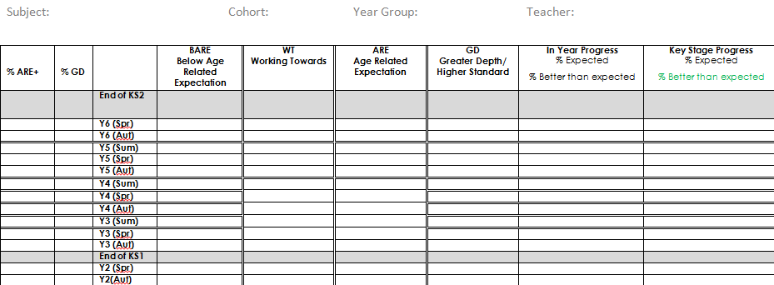
How do we track children?

Slide 32
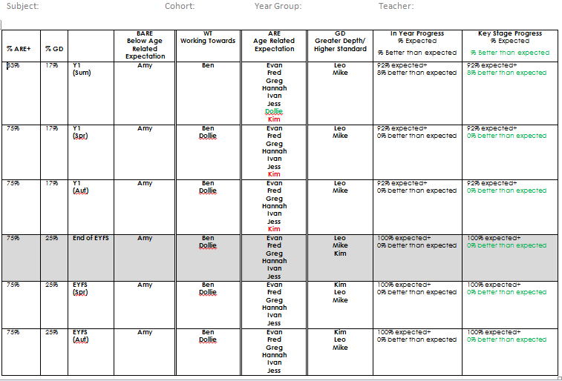
How do we track children?

Slide 33
Assessing pupils with SEND
Assessment is used to identify pupils’ SEND requirements and determine their ongoing support needs as early as possible.
High expectations are held for pupils with SEND and SMART targets are set within their Provision Maps.

Slide 34
Assessing pupils with SEND
Formal Assessment
SEND children are tracked the same way, however at St Mary’s we use an a,b,c,d method of tracking against the year groups expectations.
A= Approximately 80% of the objectives met
B= Approximately 60% of the objectives met
C= Less than 40% of the band met
D = Less than 20% of the band met
So a child in year 5 may be working at Year 4B which means they are currently working at year 4 with 60% of the objectives being met.
This provides a more detailed assessment of SEND children.

Slide 35
Foundation Subjects
Art, DT, PE, Music, MFL, History, Geography, Computing, PSHE/RSE
Teachers use formative assessment to assess foundation subjects.
For a child to be at age related expectations (ARE), they will need to achieve all knowledge and skills for their year group.
New this year
There will no longer be a Greater Depth assessment used for Foundation Subjects as there is no criteria for this. Any child who demonstrates an excellence within a subject, will be identified as Pathway to Excellence (P2E). This may include demonstrating a particular skill in school or at home e.g. gaining grades for a musical instrument or being selected to play for an academy. Fewer children will gain P2E so please communicate with school about your child’s achievements at home.

Slide 36
Pupil Progress Meetings
All teachers meet with Mrs Hayes and myself as SEND Lead at the end of every term to discuss pupil progress. These meetings are rigorous and ensure that all children and their learning needs are discussed. This ensures that our leadership team are fully informed of the children who are making excellent progress in classes and any child who is becoming a concern. For any child who is not making progress, the following steps are taken
Parents are informed by the class teacher and a discussion takes place about anything that could be affecting the child’s learning e.g. sick family member. Support at home maybe discussed e.g. hearing your child read.
Precision teach or intervention is put into place to support the areas of learning that the child may have gaps in.
The child is closely monitored by all the staff team in the class to support their learning needs.
The leadership team are kept informed.

Slide 37
Reporting to parents
Parents will receive each year:
Termly data reports in January & April
Parents Evenings face to face – November & February
End of school report – July
We always have an Open Door Policy – if any parent has a concern at any time, please contact the school office to make an appointment with the class teacher in the first instance. They know your child best!

Slide 38
Thank You for attending.
We hope you found it useful.
Tonight is not the time to discuss any individual children. Please contact you child's class teacher if you have any concerns.
I know there is a lot to take in so if you have any questions,please email or catch myself or Mr. Nalton on the playground.
We want to work with you.
THANK YOU

